Slide 1
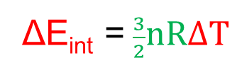

Lecture 7
Chapter 19: The Kinetic Theory of Gases
19-7 Internal Energy, E_{int} = $\frac{3}{2}nRT:monatomic ideal gas$
Assume that ideal gas is a monatomic gas (He, Ne, Ar - individual atoms) [not a molecule - H₂, O₂ etc]
Assume that the internal energy E_{int} is the sum of the translational kinetic energies of the atoms.
(Quantum theory disallows rotational kinetic energy for individual atoms.)
For one mole of an ideal monatomic gas:
Internel energy, E_{int} = kinetic energy, K + potential energy, U
E_{int} = K + U
E_{int} = K + 0
U = 0 for free particles
The average translational kinetic energy of a single atom depends only on the gas temperature and is given by, K_{avg} = $\frac{3}{2}kT$
E_{int} = K
For n moles of an ideal monatomic gas: Total number of atoms (in n moles), N = n N_{A} and Boltzmann constant, $k = \frac{R}{N_{A}}$.
E_{int} = N K_{avg} = ( n N_{A})($\frac{3}{2}kT)$ = (n N_{A}){$\frac{3}{2} (\frac{R}{N_{A}})T\}=\frac{3}{2}nRT$
E_{int} = $\frac{3}{2}nRT$
ΔE_{int} = $\frac{3}{2}nRΔT$
The internal energy E_{int} of an ideal gas is a function of the gas temperature only; it does not depend on any other variable.

Slide 2
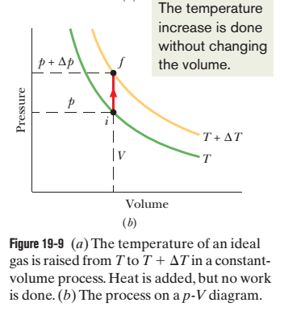
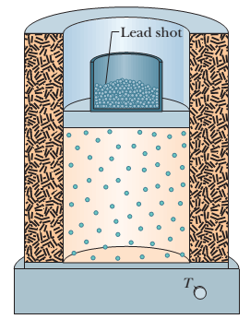
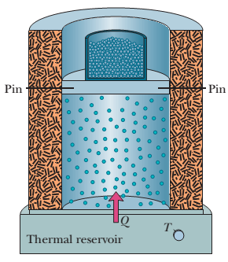
19-7 Molar Specific Heat at Constant Volume, C_{V} :
Taking n moles of an ideal gas
W =0
+ Q
i(p, T, V)
f(p+Δp, T+ ΔT, V)
i( p, T, V) Q is added slowly f(p+Δp, T+ ΔT, V)
The heat Q is related to the temperature change ΔT by
Q = nC_{V} ΔT [V = constant]
[Q = mcΔT]
1st law of thermodynamics:
ΔE_{int} = Q – W = nC_{V} ΔT – pΔV = nC_{V} ΔT– p(V – V) = nC_{V} ΔT– p(0) = nC_{V} ΔT

Slide 3
19-7 Molar specific heat of a monatomic ideal gas at constant volume: C_{V} = $\frac{3}{2}R$
Molar Specific Heat at Constant Volume, C_{V} :
Taking n moles of an ideal gas
W =0
+ Q
i(p, T, V)
f(p+Δp, T+ ΔT, V)
i( p, T, V) Q is added slowly f(p+Δp, T+ ΔT, V)
The heat Q is related to the temperature change ΔT by
Q = nC_{V} ΔT [V = constant]
[Q = mcΔT]
1st law of thermodynamics:
ΔE_{int} = Q – W = nC_{V} ΔT – pΔV = nC_{V} ΔT– p(V – V) = nC_{V} ΔT– p(0) = nC_{V} ΔT

Slide 4
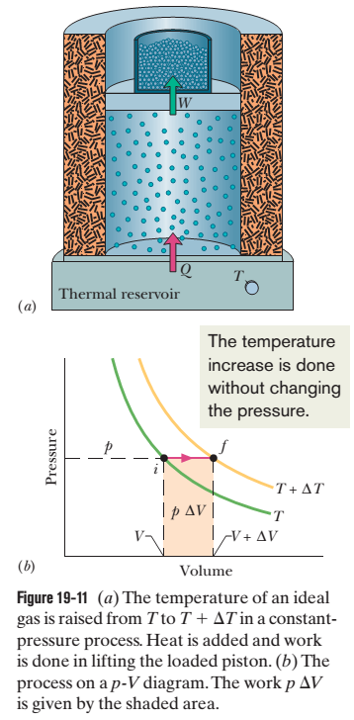
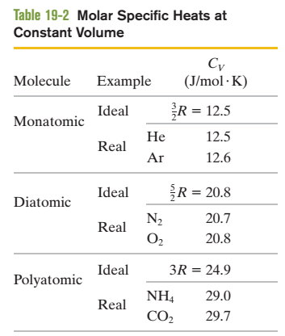

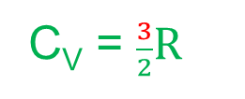
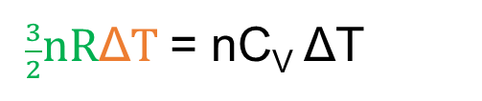
ΔE_{int} = nC_{V} ΔT [but ΔE_{int} = $\frac{3}{2}nR\text{Δ}T]$
$\frac{3}{2}nR\text{Δ}T$= nC_{V} ΔT
C_{V} = $\frac{3}{2}R$
$$[monatomic gas]$$
C_{V} = $\frac{3}{2}R=\frac{3}{2} \left(8.31\right)=12.5 J /mol−K [monatomic gas]$
The C_{V} values for diatomic and polyatomic gases are greater than for monatomic gases because the more complex molecules can rotate and thus have rotational kinetic energy.

Slide 5

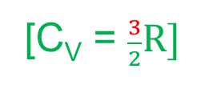

19-7 Generalize E_{int} = $\frac{3}{2}nRT for monoatomic gas: \text{E}\text{int}\text{ = }\text{nCVT} \text{for} \text{any} \text{gas}$
We can now generalize E_{int} = $\frac{3}{2}nRT$for the internal energy of any ideal gas by substituting C_{V} = $\frac{3}{2}R$.
E_{int} = $\frac{3}{2}nRT$
E_{int} = n($\frac{3}{2}R)T$
[C_{V} = $\frac{3}{2}R]$
E_{int} = nC_{V}T [any ideal gas]
This equation applies not only to an ideal monatomic gas but also to diatomic and polyatomic ideal gases, provided the appropriate value of C_{V} is used.
When a confined ideal gas undergoes temperature change ΔT, then the resulting change in its internal energy is
ΔE_{int} = nC_{V} ΔT [ideal gas for any process]
“A change in the internal energy E_{int} of a confined ideal gas depends on only the change in the temperature, not on what type of process produces the change”.

Slide 6
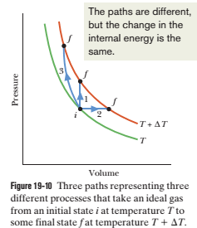
No matter what path is actually taken between T and T+ ΔT, we can always use path 1 and ΔE_{int} = nC_{V} ΔT to compute ΔE_{int} easily.

Slide 7
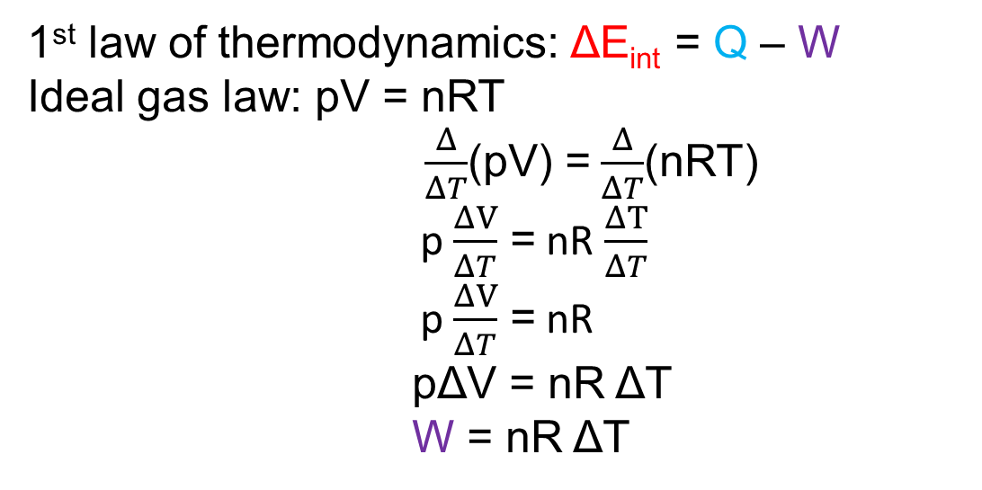
19-7 Molar Specific Heat at Constant Pressure, C_{p} :
The temperature of our ideal gas is increased by the same small amount ΔT as previously but now the necessary energy (heat Q) is added with the gas under constant pressure.
f(p, T+ ΔT, V+ΔV)
i( p, T, V) Q is added slowly f(p, T+ ΔT, V+ΔV)
The heat Q is related to the temperature change ΔT by
Q = nC_{p} ΔT [p = constant]
Relation between molar specific heats C_{p} and C_{V} :
1st law of thermodynamics: ΔE_{int} = Q – W
Ideal gas law: pV = nRT
$\frac{Δ}{ΔT}$(pV) = $\frac{Δ}{ΔT}$(nRT)
p $\frac{ΔV}{ΔT}$ = nR $\frac{ΔT}{ΔT}$
p $\frac{ΔV}{ΔT}$ = nR
pΔV = nR ΔT
W = nR ΔT

Slide 8
ΔE_{int} = Q – W
[ A change in the internal energy E_{int} of a confined ideal gas depends on only the change in the temperature, not on what type of process produces the change, ΔE_{int} = nC_{V} ΔT ]
nC_{V} ΔT = nC_{p} ΔT – nRΔT
C_{V} nΔT = C_{p} nΔT – R nΔT
C_{V} = C_{p} – R
[divide by nΔT]
C_{p} – C_{V} = R
This prediction of kinetic theory agrees well with experiment, not only for monatomic gases but also for gases in general, as long as their density is low enough so that we may treat them as ideal.
C_{p} is greater than C_{v} :
This C_{p} is greater than the molar specific heat at constant volume C_{V}, because energy must now be supplied not only to raise the temperature of the gas but also for the gas to do work as shown in Fig.

Slide 9
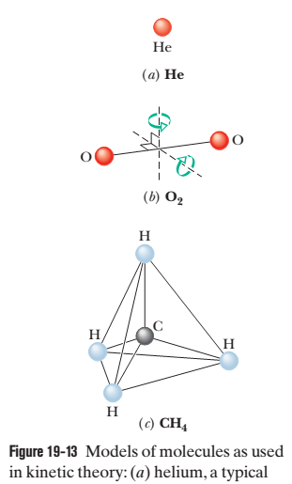
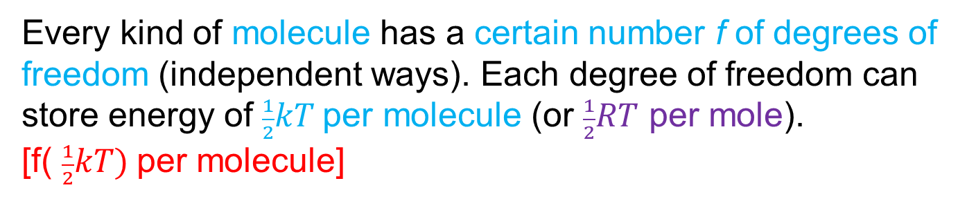
19-8 Degrees of freedom and molar specific heats: E_{int} = ( $\frac{f}{2})nRT$ and C_{V} = ($\frac{f}{2})R$
The prediction that agrees with experiment for monatomic gases but fails for diatomic and polyatomic gases.
Let us try to explain that molecules with more than one atom can store internal energy in forms other than translational kinetic energy.
Figure 19-13 shows common models of helium (a monatomic molecule, containing a single atom), oxygen (a diatomic molecule, containing two atoms), and methane (a polyatomic molecule).
James Clerk Maxwell introduced the theorem of the equipartition of energy:
Every kind of molecule has a certain number f of degrees of freedom (independent ways). Each degree of freedom can store energy of $\frac{1}{2}kT$per molecule (or $\frac{1}{2}RT$ per mole).
[f( $\frac{1}{2}kT)$per molecule]

Slide 10
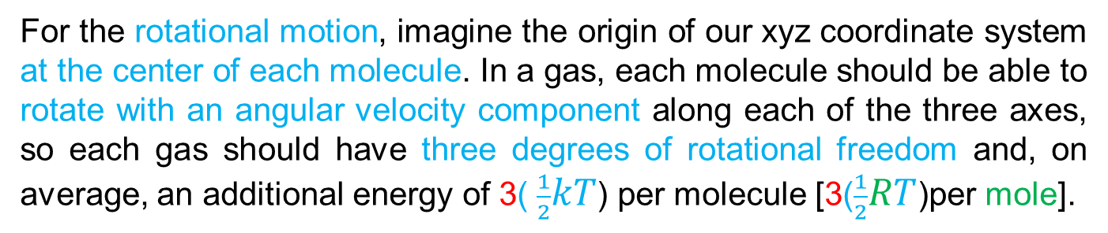
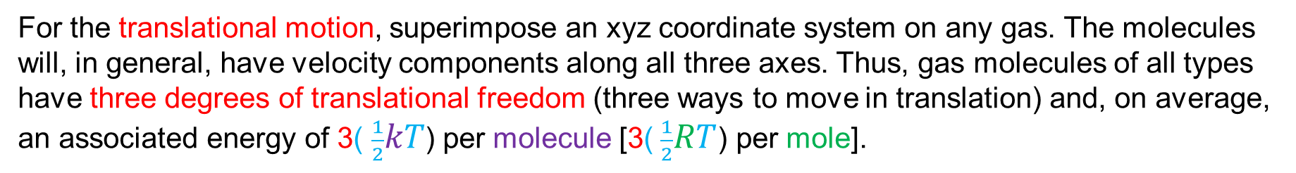
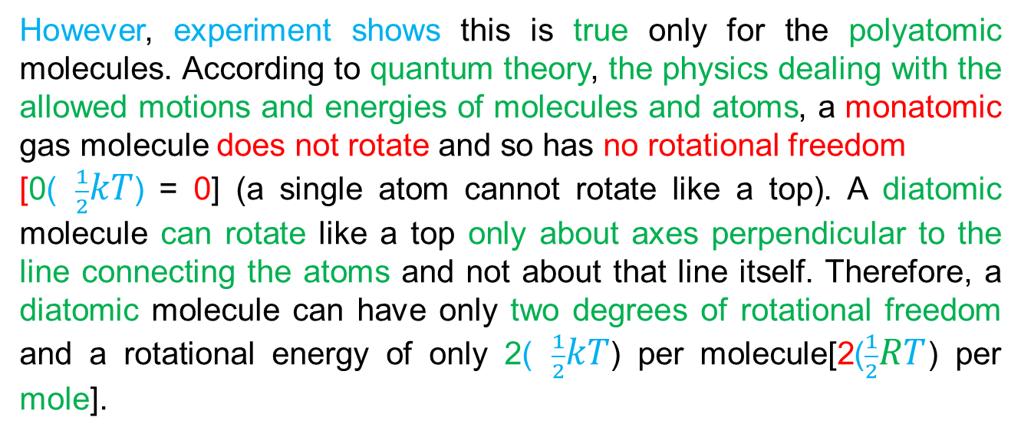
For the translational motion, superimpose an xyz coordinate system on any gas. The molecules will, in general, have velocity components along all three axes. Thus, gas molecules of all types have three degrees of translational freedom (three ways to move in translation) and, on average, an associated energy of 3( $\frac{1}{2}kT$) per molecule [3( $\frac{1}{2}RT$) per mole].
For the rotational motion, imagine the origin of our xyz coordinate system at the center of each molecule. In a gas, each molecule should be able to rotate with an angular velocity component along each of the three axes, so each gas should have three degrees of rotational freedom and, on average, an additional energy of 3( $\frac{1}{2}kT$) per molecule [3($\frac{1}{2}RT$)per mole].
However, experiment shows this is true only for the polyatomic molecules. According to quantum theory, the physics dealing with the allowed motions and energies of molecules and atoms, a monatomic gas molecule does not rotate and so has no rotational freedom
[0( $\frac{1}{2}kT$) = 0] (a single atom cannot rotate like a top). A diatomic molecule can rotate like a top only about axes perpendicular to the line connecting the atoms and not about that line itself. Therefore, a diatomic molecule can have only two degrees of rotational freedom and a rotational energy of only 2( $\frac{1}{2}kT$) per molecule[2($\frac{1}{2}RT$) per mole].

Slide 11
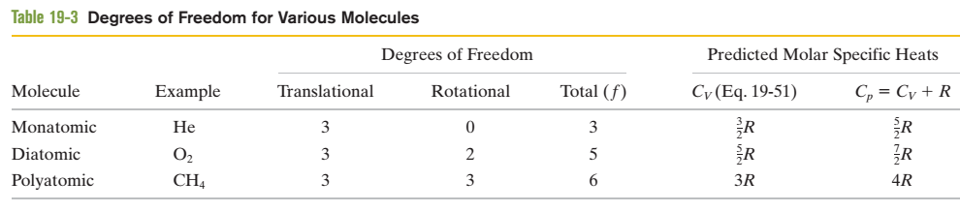
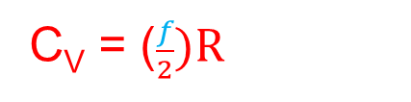
To extend our analysis of molar specific heats to ideal diatomic and polyatomic gases, it is necessary to retrace the derivations of that analysis in detail. First, we replace E_{int} = (3/2) nRT
with E_{int} = (f/2) nRT, where f is the number of degrees of freedom [Table 19-3]. Doing so leads to the prediction
C_{V} = ($\frac{f}{2})R$
This agrees for monatomic gases (f = 3). As Table 19-3 shows, this prediction also agrees with experiment for diatomic gases (f =5), but it is too low for polyatomic gases (f = 6 for molecules comparable to CH₄).
Methane, CH4

Slide 12
Ammonium, NH4

Slide 13
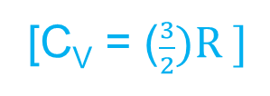
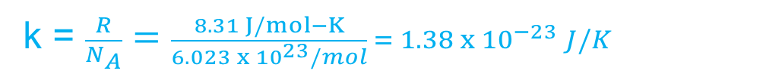
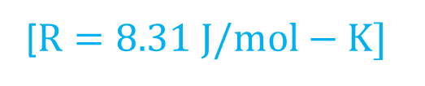
47. The temperature of 2.00 mol of an ideal monatomic gas is raised 15.0 K at constant volume. What are (a) the work W done by the gas, (b) the energy transferred as heat Q, (c) the change ΔE_{int} in the internal energy of the gas, and (d) the change ΔK in the average kinetic energy per atom?
Solution:
Here, n = 2.00 mol
ΔT= 15 K
ΔV = V - V = 0
k = $\frac{R}{N_{A}}=\frac{8.31 J/mol−K}{6.023 x {10}^{23}/mol} = 1.38 x {10}^{−23 }J/K$
(a) W = pΔV = p(0) = 0
[C_{V} = ($\frac{3}{2})R ]$
(b) Q = nC_{V}ΔT = n ($\frac{3}{2})R$ ΔT = 2.00 ($\frac{3}{2})8.31 ($15) = 373.95 J
[$R=8.31 J/mol−K]$
(c) ΔE_{int} = Q – W = 373.95 – 0 = 373.95 J
(d) ΔK = ($\frac{3}{2})k$ΔT = ($\frac{3}{2})(1.38 x {10}^{−23})$15 = 31.05 $x {10}^{−23}$ J

Slide 14
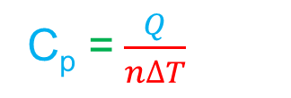
48. When 20.9 J was added as heat to a particular ideal gas, the volume of the gas changed from 50.0 cm³ to 100 cm³ while the pressure remained at 1.00 atm. (a) By how much did the internal energy of the gas change? If the quantity of gas present was 2.00x10⁻³ mol, find (b) C_{p} and (c) C_{V}.
Solution:
Here, Q = +20.9 J
ΔV = (100 – 50) cm³ = 50 cm³ =50(10⁻² m)³ = 50x10⁻⁶ m³
p = 1.00 atm = 1x10⁵ Pa
n = 2.00x10⁻³ mol
(a) ΔE_{int} = Q – W = Q – p ΔV = 20.9 – 1x10⁵(50x10⁻⁶) = 20.9 – 5.0 = 15.9 J
(b) Q = nC_{p}ΔT
[p = constant]
C_{p} =$\frac{Q}{n∆T}$

Slide 15
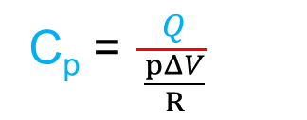
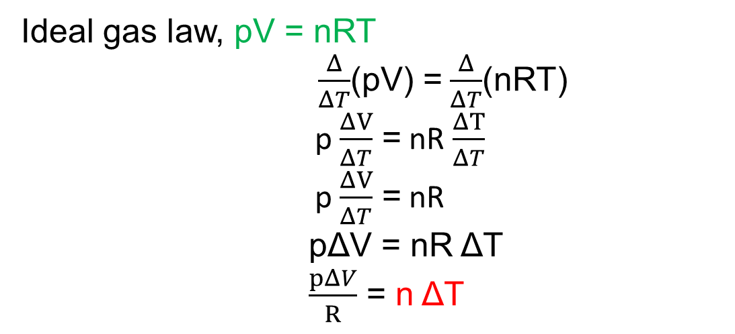
Ideal gas law, pV = nRT
$\frac{Δ}{ΔT}$(pV) = $\frac{Δ}{ΔT}$(nRT)
p $\frac{ΔV}{ΔT}$ = nR $\frac{ΔT}{ΔT}$
p $\frac{ΔV}{ΔT}$ = nR
pΔV = nR ΔT
$\frac{pΔV}{R}$ = n ΔT
C_{p} =$\frac{Q}{\frac{pΔV}{R}}$
C_{p} =$\frac{QR}{p∆V}$ = $\frac{20.9(8.31)}{\text{1}\text{x}{10}^{5}\text{(}\text{50}\text{x}{10}^{−6}\text{)} }$ = $\frac{173.68}{5.0}$ = 34.74 J/mol-K
(c) C_{p} – C_{V} = R
C_{V} = C_{p} – R = 34.74 – 8.31 = 26.43 J/mol-K

